Slide 1

TutorTools
Prepared for: CSCI/CMPE 3340 Software Engineering I
Instructor: MK Quweider, Ph.D.
Spring 2018

Slide 2
Software Engineering Code of Ethics and Professional Practice
Public. Software engineers shall act consistently with the public interest.
Client and employer. Software engineers shall act in a manner that is in the best interests of their client and employer, consistent with the public interest.
Product. Software engineers shall ensure that their products and related modifications meet the highest professional standards possible.
Judgment. Software engineers shall maintain integrity and independence in their professional judgment.
Management. Software engineering managers and leaders shall subscribe to and promote an ethical approach to the management of software development and maintenance.
Profession. Software engineers shall advance the integrity and reputation of the profession consistent with the public interest.
Colleagues. Software engineers shall be fair to and supportive of their colleagues.
Self. Software engineers shall participate in lifelong learning regarding October 1999 85 Software Engineering Code of Ethics and Professional Practice the practice of their profession and shall promote an ethical approach to the practice of the profession.

Slide 3
What is TutorTools?
TutorTools is a database driven JavaFx application to store data for tutor programs.
TutorTools allows users to add and edit information for students, tutors, and tutoring sessions, and give a visual organization of the collected information.
TutorTools allows users to request tutoring for specific subjects and tutors.
TutorTools allows users to submit data once it has been checked making accurate the end time and date of tutoring sessions.

Slide 4
Who is going to use TutorTools?
The main type of users that will interact with TutorTools are tutor programs within schools considering, they are managed by a supervisor, they have working tutors, and students that attend sessions.
Students are able to input information to request tutoring and are able to see a list of other students requesting tutoring
Tutors are able to modify information of tutoring sessions and some information of students.
Supervisor are able to add students and tutors, and modify their information.

Slide 5
Local and Global Impact
Help schools tutoring programs with management of data.
Reduce complexity of saving information for tutoring sessions.
Provide visual compilation of data to give feedback for future improvements.
Provide programs with a tool to track tutoring sessions.

Slide 6
Goal
To provide tutor programs an application with an easy way to manage and save data.
Help Increase amount of students that participate in tutor programs with easy access to their preferred tutors.

Slide 7
Layered Architecture
Components of our project were divided into horizontal layers, each performing a specific role within the application.
Presentation – responsible for presenting the user-interfaces to the end-user.
Persistence- responsible for the technical stuff(e.g. retrieving information from database, or sending it to the presentation layer).
Database- responsible for organizing and containing all the information needed.

Slide 8
Product Functions
Login Security
The ability to authorize/deny access using unique username and password.
Database Connectivity
The ability to connect to a database to create, modify, and delete data.
Email Service
The ability to send announcement to the student and tutors through email.
Session Creation
The ability to create new sessions for students.
Information Management
The ability to register a student/tutor information, modify, and delete their information.

Slide 9
Logical Database Requirements
A Database (SQL) is used for the storage of information inputted to the application. The Software ask for certain fields of input that match the fields in the database as rows and columns. The information is identified using the ID numbers as an identifier. Information of students, tutors, and supervisor are called from the database and shown into the application.

Slide 10
Members
Members:
Bethsua Martinez
Luis Selvera
Kenneth Segarra
Elyvic Cabais

Slide 11
Responsibilities
Student Views
Elyvic Cabais
Tutor Views
Bethsua Martinez
Supervisor Views
Kenneth Segarra
Database
Luis Selvera

Slide 12
Backlog Items

Slide 13
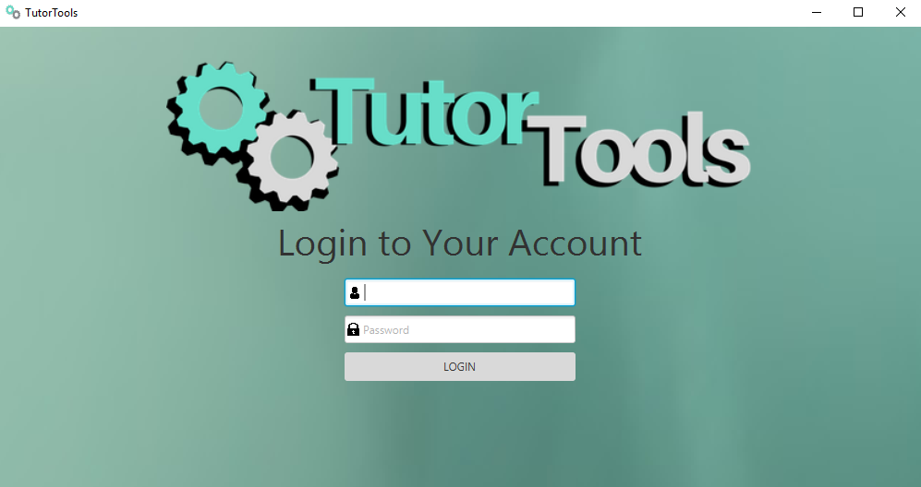
Login
Login
Users login with username and password

Slide 14
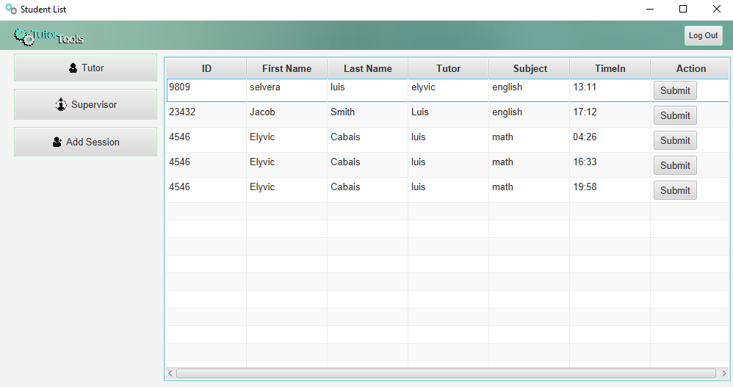
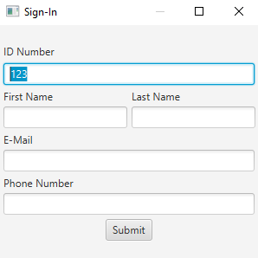
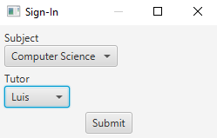
Student List
Student List
Add Session
Returning Student
Subject
Tutor
New Student Sign-In
ID Number
Name
E-mail
Phone Number

Slide 15
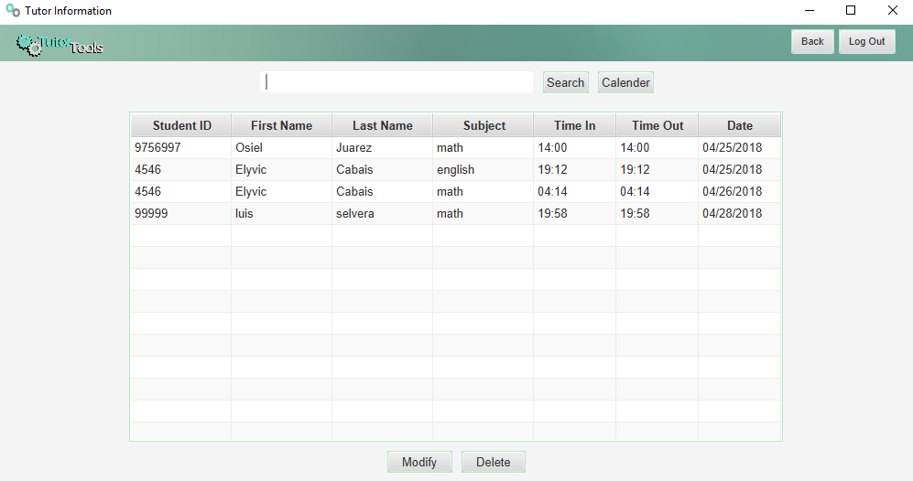
Tutor Scene
Tutor's Session
Modify Student Information
Delete Student From Session
Search Student

Slide 16
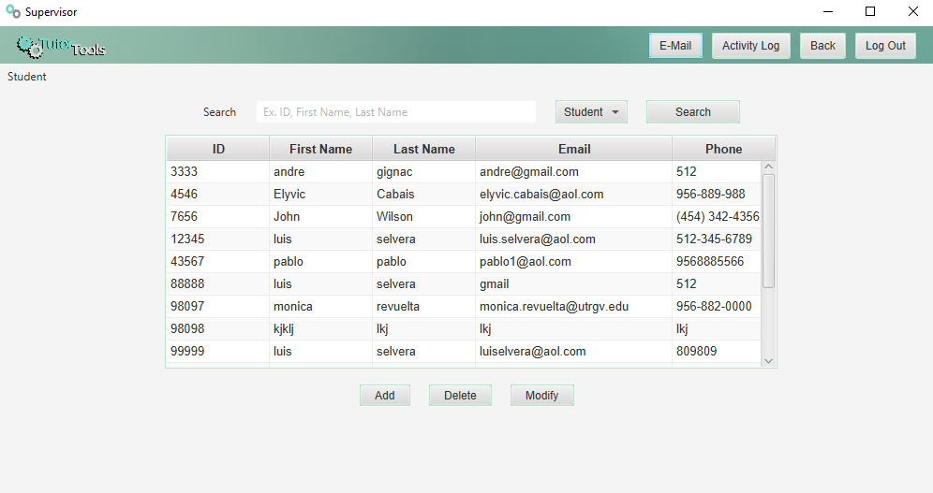
Supervisor Scene
Supervisor Menu
Modify Student/Tutor Information
Delete Student/Tutors
Search Student/Tutor

Slide 17
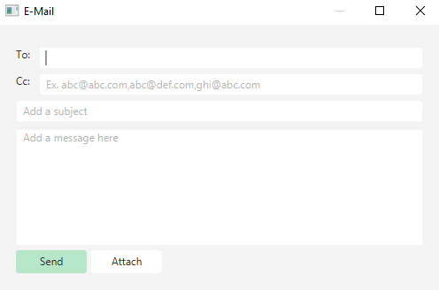
Email
Announcement
Send announcement for tutor or students
Send attachments

Slide 18
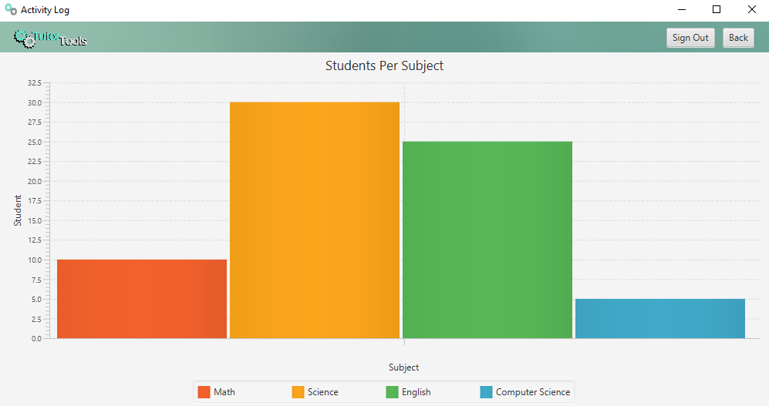
Activity Log
Tutoring Activity
Shows how many students per subject

Slide 19
Future Improvements
Add option to create appointment with tutors
Improve database
Add more visuals to make application more appealing for users
Be able to add notes in each sessions.
Add a calendar with tutors schedule and other announcements

Slide 20
Conclusion
TutorTools is the ultimate tool for any tutor. This application software allows users to load tutor and student information with ease. Creating new session for each student that sign-in for tutors to then pick them out for their tutoring session. Tutor will be able to manage all of their students that sign in for their sessions. Supervisor will be the only user that will have the power to update information for both students and tutors. Of course as any other software, the process is still not over. We will continue to further develop and improve our software to make it the best there is.

Slide 21
Any Questions?

Slide 22

Thanks For Watching

